Slide 1
Stem cell and its role in Oncogenesis
Presented by : Prachi (30628)

Slide 2
Cancer Stem Cells:
The stem cells which are involved in oncogenesis are known as Cancer Stem Cells (CSC).
The Cancer Stem Cells are a small subpopulation of cells within tumors with capabilities of self- renewal, differentiation and tumorigenicity when transplanted into an animal host.
The first convincing evidence of CSCs was reported by Bonnet and Dick in 1997.

Slide 3
Characteristics of CSC’s:
Self- renewal
Drug resistance
Tumorigenicity
Metastasis

Slide 4
Phenotypic distinction between normal hsc and aml stem cells
Normal HSC
AML stem cell
Self-renew
High differentiative potential
Differentiation highly regulated
Long life span, resistant to apoptosis
CD34 CD38
CD90 CD117 CD123
Self-renew
High differentiative potential
Differentiation poorly regulated
Long life span, resistant to
Apoptosis
CD34 CD38 CD90
CD117 CD123

Slide 5
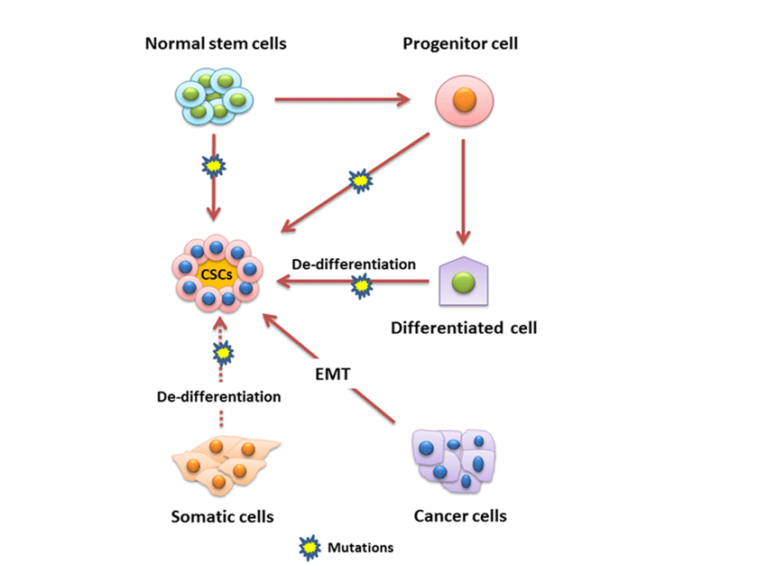
Origin of Cancer Stem Cell:

Slide 6
Cancer Stem Cell Hypothesis:
The cancer stem-cell (CSC) hypothesis suggests that there is a small subset of cancer cells that are responsible for tumor initiation and growth, possessing properties such as indefinite self-renewal, slow replication, intrinsic resistance to chemotherapy and radiotherapy, and an ability to give rise to differentiated progeny.
The CSC hypothesis contrasts with the working theory for oncogenesis, that differentiated cells become tumorigenic through accumulation of mutations in proto oncogenes or tumour suppressor genes

Slide 7
Conti…..
Current models of tumorigenic progression usually relate oncogenesis to the accumulation of a series of molecular events within the cell, such as gene mutations and chromosomal translocations.
It has long been known that solid tumours comprise a heterogeneous collection of cell types, and that only a small proportion of cells in a tumour are able to form new colonies in vitro and in vivo.

Slide 8
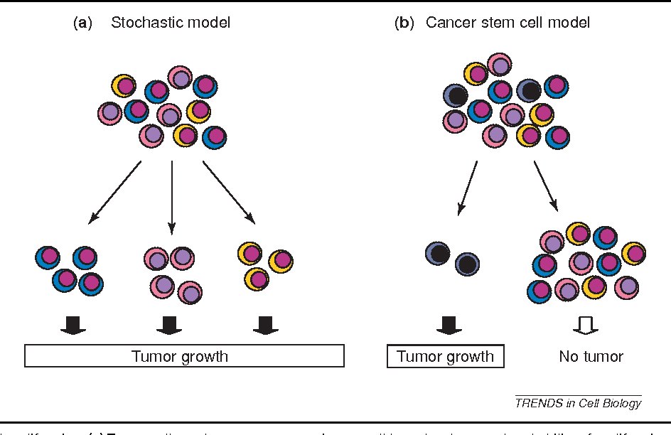
Models :

Slide 9
Role of Niche:
The stem cell niche is an area of a tissue that provides a specific microenvironment
The cellular and non cellular components of the niche provide signals the regulate proliferative and self- renewal signals, thereby helping CSCs to maintain their undifferentiated state.
Non- epithelial stromal cells, inflammatory cells and the vasculature have been proposed as key components of the niche that support and sustain CSCs.

Slide 10
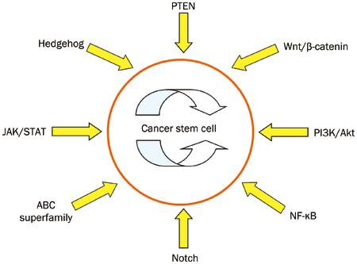
Key Signalling Pathways:

Slide 11
JAK/ STAT signalling Pathway:
Evidence that this pathway is activated aberrantly CSCs has been found in stem- like cells isolated from tumours of the breast, prostate, blood.
Tumor growth factor- beta (TGF- β) was shown to regulate the self- renewal and differentiation properties of glioma- initiating cells derived from patient samples of glioblastoma multiforme.

Slide 12
NF- κB Pathway:
Dysfunction of NF-κB is observed in multiple myeloma, chronic lymphocytic leukaemia and several other lymphomas, in which the NF-κB gene is constantly activated.
Wnt Pathway:
Dysregulation of Wnt signalling is critical to the initiation of epithelial carcinomas like colon cancer. Wnt signalling may also be involved in lymphoid leukaemia.
Notch Pathway:
The notch pathway, has been demonstrated to regulate the properties of tumour cells in many cancers, including leukemia, glioblastoma and those of the breast, colon, pancreas and lung

Slide 13


